Slide 1
CARMS Overview
Client Access Request Management System

Slide 2
Key Features
✅ React + Zustand frontend
✅ .NET Core API backend
✅ EF Core with seeding
✅ Swagger docs + Postman
✅ Role-based workflows
✅ Notification & Access API

Slide 3
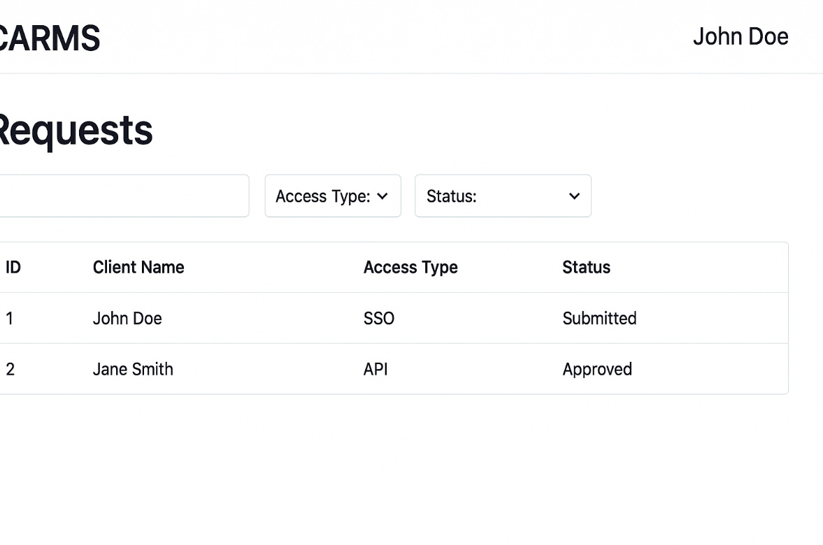
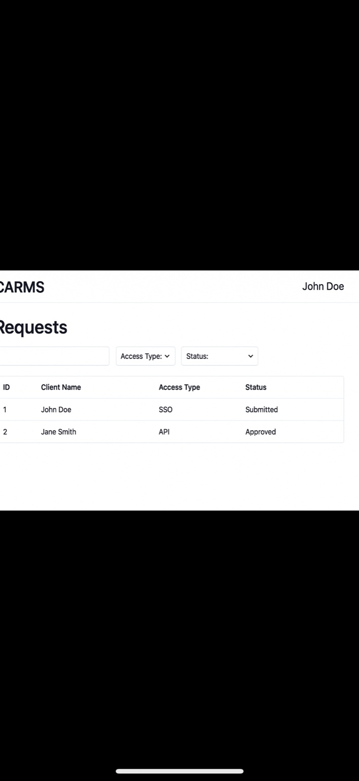
Homepage

Slide 4
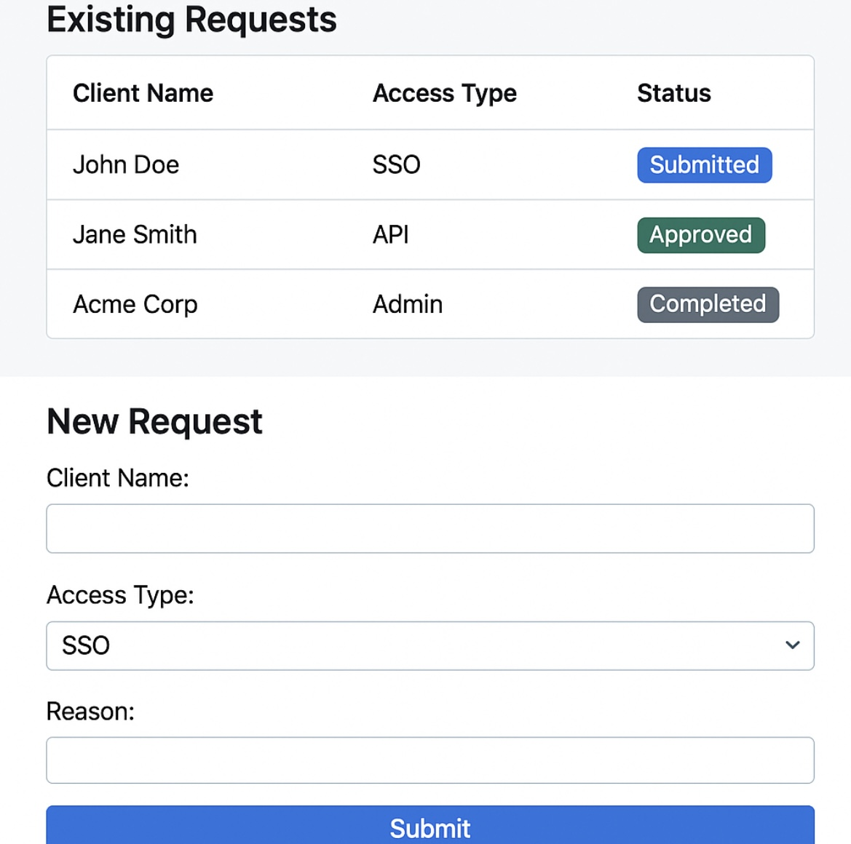
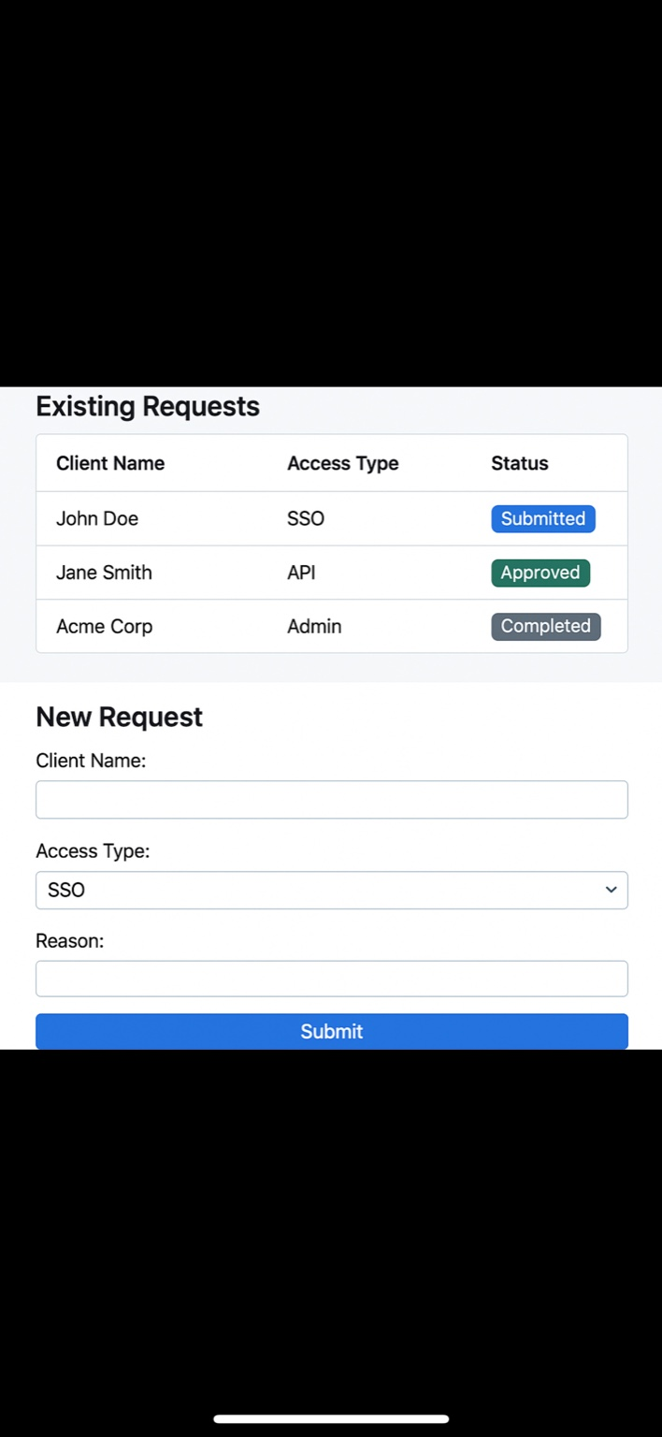
New Request Form

Slide 5
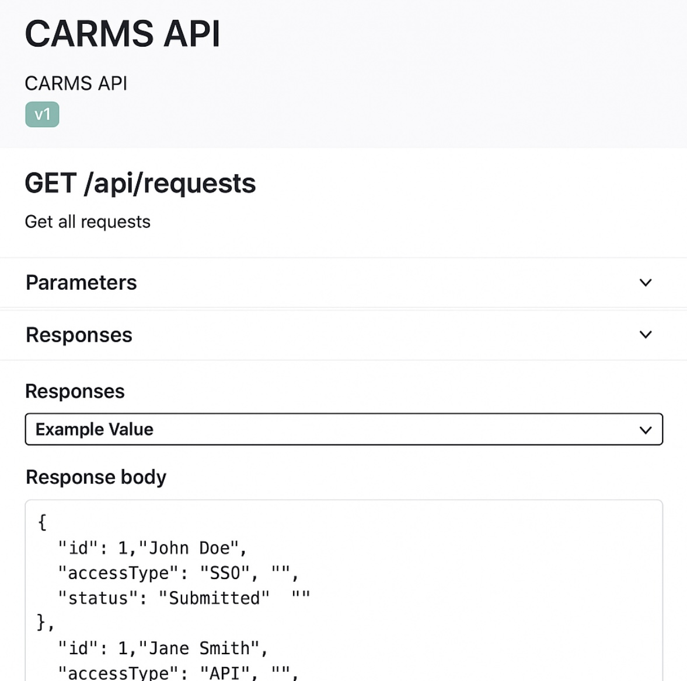
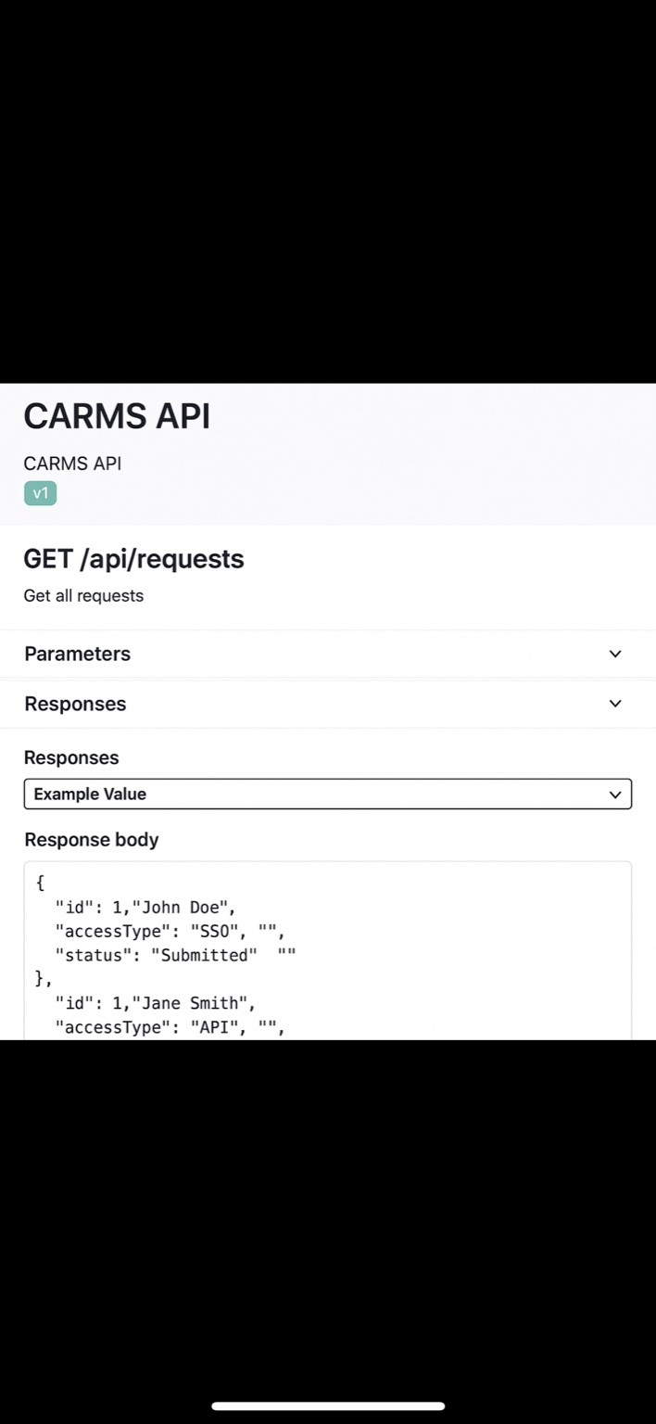
Swagger API Docs

Slide 6
Future Enhancements
🔐 OIDC Auth (Okta/Azure AD)
📊 Role-based dashboards
📝 Audit logs
📫 Email/webhook alerts
🐳 Docker + CI/CD pipeline

Slide 7
Backend File Structure
CARMS.Api/
├── Controllers/
├── Data/
├── DTOs/
├── Interfaces/
├── Middleware/
├── Models/
├── Services/
├── Program.cs
├── Startup.cs
└── appsettings.json

Slide 8
Frontend File Structure
carms-frontend/
├── public/
├── src/
│ ├── assets/
│ ├── components/
│ ├── pages/
│ ├── services/
│ ├── hooks/
│ ├── utils/
│ ├── store/
│ └── context/
├── App.js
├── index.js
└── package.json

Slide 9
Application Requirements Summary
✔ Manage external access requests from clients
✔ Allow submission, review, and status updates
✔ Support notification and external access APIs
✔ Enable OpenID authentication (Okta/Azure AD)
✔ Track and log actions for auditing
✔ Provide dashboard views for admins and requesters

